Slide 1

Biopotential Controlled Aerial Vehicle
Next-Generation Human-Machine Interfacing (HMI)
Amogh Bhosekar (612309009)
Nihar Joshi (612309025)
Mentor: Dr. Uttam Chaskar
COEP Technological University, Pune

Slide 2



Project Abstract
Developing a Biopotential Controlled UAV designed for high-fidelity aerial navigation, specifically targeting assistive technology and hands-free teleoperation.
Interpret user intent via EMG multimodal signals.
Classification of 6 distinct flight commands.
Implementation of Support Vector Machines (SVM).
Evaluation of conductive fabric as skin-electrode surfaces.

Slide 3





Background & Context
Biopotentials
Assistive Tech
Neurological Intent
Utilizing electrical activity generated by neurological and physiological processes (EEG, EMG, EOG).
Enabling individuals with severe motor disabilities to navigate environments hands-free.
Transitioning from manual RF controllers to intuitive, intent-based flight command systems.
"The system relies on Event-Related Desynchronization (ERD) and Synchronization (ERS) for motor imagery detection."

Slide 4
The Challenge
Intention-to-Execution Gap
Reliably translating complex, noisy EEG/EMG data into real-time commands is the primary bottleneck.
Signal Noise: Environmental and biological artifacts.
Latency: Bridging the delay between thought and drone movement.
Predictability: Mapping non-linear signals to stable multi-axis flight.

Slide 5





Technical Objectives
Objective 1
Objective 2
Objective 3
Design a 4-channel EMG Analog Front End (AFE) for precise signal conditioning.
Classification of wrist movements using EMG signal acquisition for flight control.
Evaluate Carbon Nanotube coated fabric as an alternative to traditional gel electrodes.

Slide 6
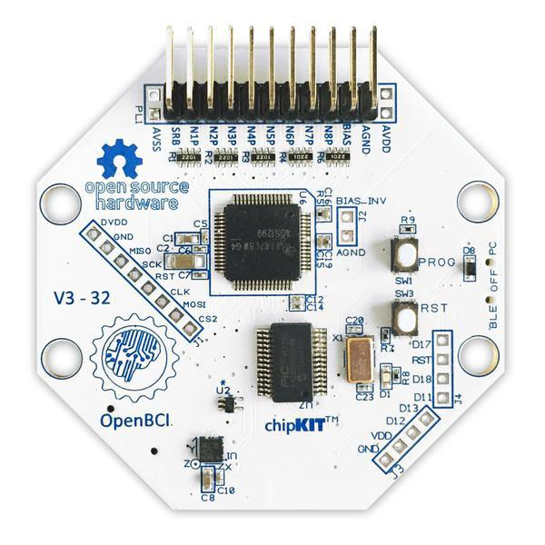
System Architecture
Acquisition: OpenBCI Cyton (8-ch) and Custom 4-ch EMG Hardware.
Processing: MATLAB environment for real-time feature extraction and SVM.
Link: Lab Streaming Layer (LSL) protocol for low-latency synchronization.
Control: HC-05 Bluetooth module communicating with On-board ESP32.

Slide 7
Core Components
ADC: Texas Instruments ADS1299 (8-channel, 24-bit resolution).
Microcontroller: PIC32MX250F128B (32-bit, 50MHz).
Bluetooth: RFduino (BLE) for wireless data transmission to a USB Dongle.
Accelerometer: LIS3DH 3-axis (measures head movement and artifacts).
Signal Quality & ADC Specs
Resolution: 24-bit (0.02235 microvolts per bit).
Sample Rate: 250 Hz (default streaming speed per channel).
Programmable Gain: 1, 2, 4, 6, 8, 12, or 24.
Common Mode Rejection Ratio (CMRR): -110dB.
Input Impedance: 1 GΩ.
Input Bias Current: 300 pA.
Connectivity & Expansion
Channels: 8 onboard channels (can be expanded to 16 channels with the Daisy Shield).
Inputs: Compatible with active or passive electrodes (EEG, EMG, ECG/EKG).
Local Storage: Integrated Micro SD card slot for standalone data logging.

Slide 8


Algorithmic Framework
Input: 4-Channel Differential Signals (EMG/EEG)
Processing: SVM Classifies Intent (6 Classes)
Action: Real-time Flight Maneuver Select

Slide 9
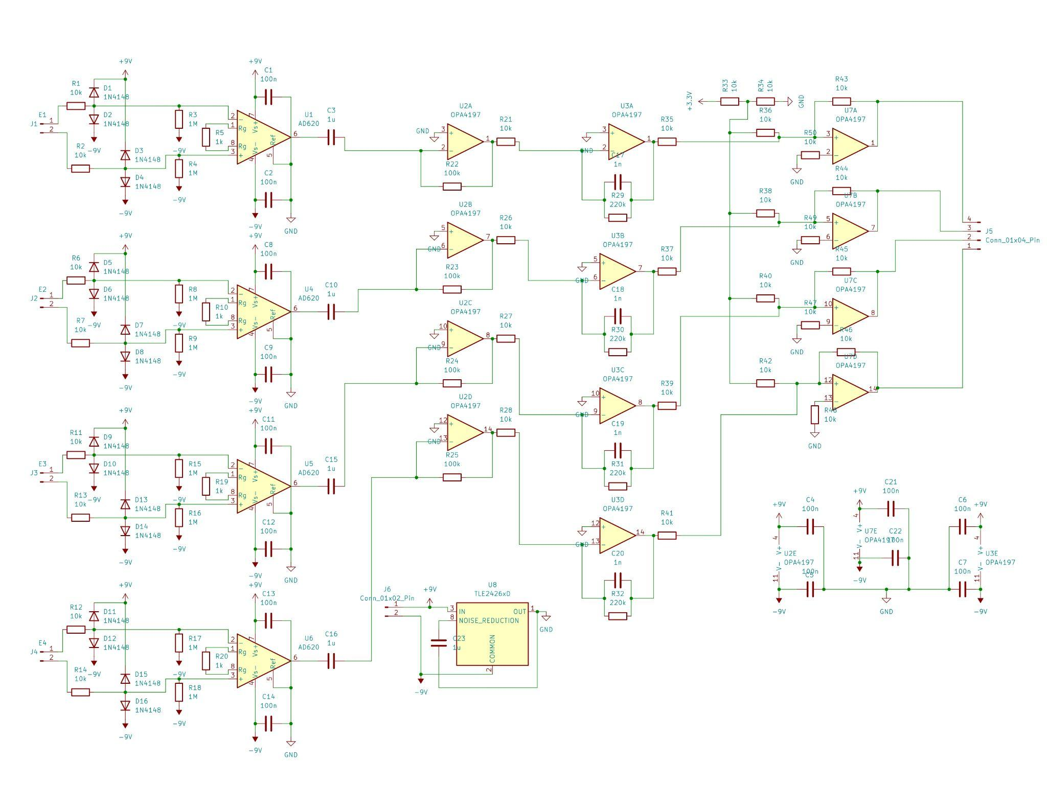
Implementation: AFE Design
Hardware Specifications
Instrumentation Amp: AD620 based 4-channel design.
Op-Amp: TL074 for filtering and buffering.
Performance: 120dB Common Mode Rejection Ratio (CMRR).
Bandwidth: Optimized from 0.05 Hz to 120 Hz.
Active Noise: Right Leg Drive (RLD) circuit for cancellation.

Slide 10
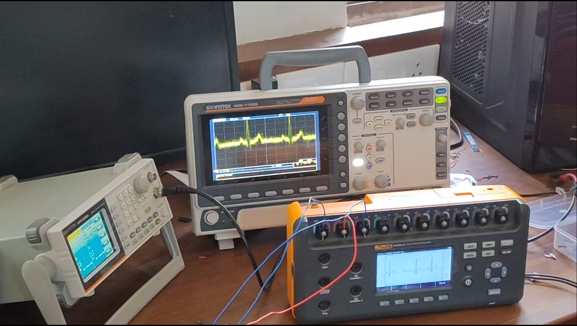

Slide 11
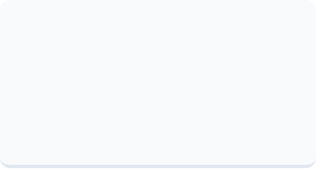

Implementation: Feature Extraction
A multi-feature extraction pipeline captures distinct EMG patterns for high-accuracy classification:
MAV
WL
SSC
Mean Absolute Value: Detects signal amplitude levels.
Waveform Length: Measures signal complexity over time.
Slope Sign Changes: Identifies frequency variations.

Slide 12

Implementation: ML Pipeline
Gaussian RBF SVM
The model utilizes a Support Vector Machine with a Gaussian Radial Basis Function (RBF) kernel for non-linear separation.
6 Navigation Classes
1.
Vertical Ascent
2.
Vertical Descent
3.
Left Rotation
Debouncing: Threshold logic to prevent erratic flight.
4.
Right Rotation
Smoothing: Alpha-filter exponential smoothing.
5.
Clockwise Twist
6.
Anti-Clockwise Twist
Kernel: RBF for complex muscle pattern mapping.

Slide 13
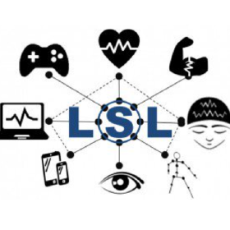
Implementation: Synchronization
Lab Streaming Layer (LSL)
Bridges hardware communication and MATLAB processing loops.
Unified, time-synchronized collection of measurement time series.
Reduces timing jitter and data loss during wireless RF/BT transmission.
Standardized abstracted networking for high-precision synchronization.

Slide 14
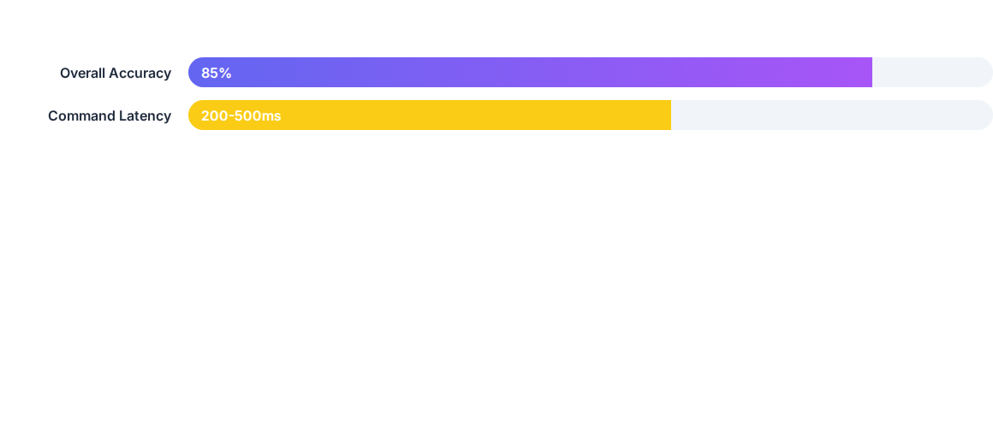
Results: SVM Performance
Action | Confidence (%) | Status
Rest State | 27.1% | Confirmed
Wrist Up (Ascent) | 21.0% | Detection Threshold
Twist Clockwise | 18.0% | Validated
Twist Anti-Clockwise | 8.1% | Low Confidence

Slide 15

Results: Electrode Evaluation
Electrode Type | Impedance | Suitability
Gel Electrodes | 1-10 kΩ | Gold Standard
Fabric (CNT) | 25-50 kΩ | Flexible / EMG
Comb (Dry) | Medium | Scalp / Hair
Fabric Viability
Carbon Nanotube (CNT) coated fabric showed higher contact impedance but offers superior comfort and wearability for flexible EMG bands.

Slide 16

Limitations & Challenges
Latency
Hair-Bearing Areas
Signal Attenuation
200-500ms delay is currently higher than traditional RF controllers (<100ms).
Practical incompatibility of standard gel electrodes with scalp regions for EEG.
Fabric electrodes require heavy signal processing due to high impedance gains.

Slide 17
Conclusion & Future Scope
Embedded Execution: Running DSP and SVM on STM32 F44ZE with 32-bit FPU.
Wearable Cap: Development of modular EEG caps with comb electrodes.
Wireless Link: Full untethered communication with UAV flight controller.
Refined SVM: Reducing latency to <100ms for competitive advantage.
Thank You! Any Questions?

